Slide 1

Advanced Early Dengue Prediction and Exploration service
aedesproject.org

Slide 2

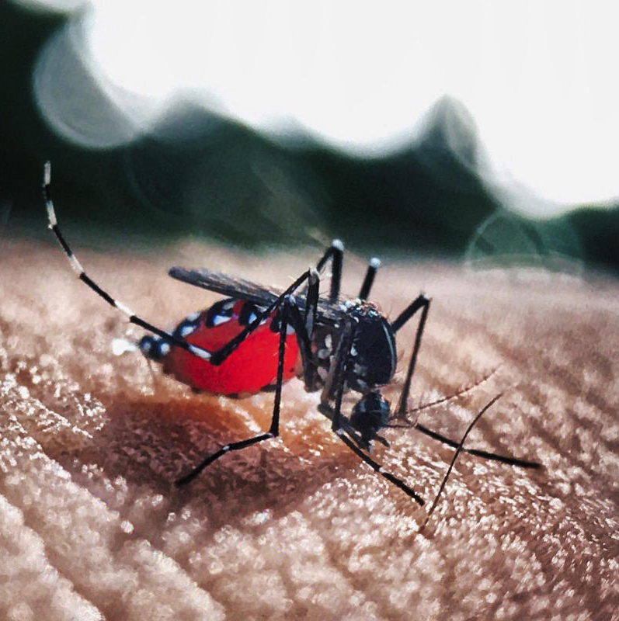
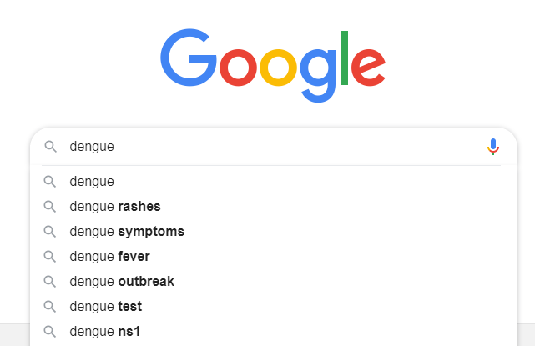
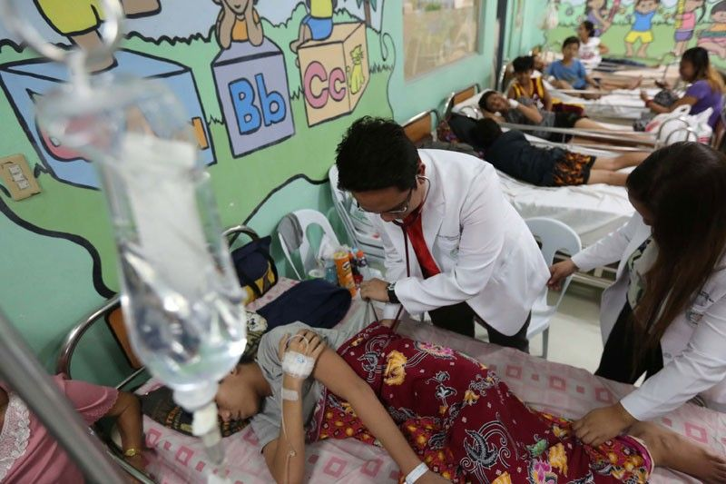

Capturing The Dengue Data Cycle
Data
Data
Data
Climate
Creates mosquito breeding environments
Mosquitoes
Get infected and spread cases of disease
Searches
Triggered by public alarm and spread of cases and deaths
Deaths
Occur if cases are untreated
Reports
Cases and deaths are reported to Department of Health (2-3 months lag)

Slide 3
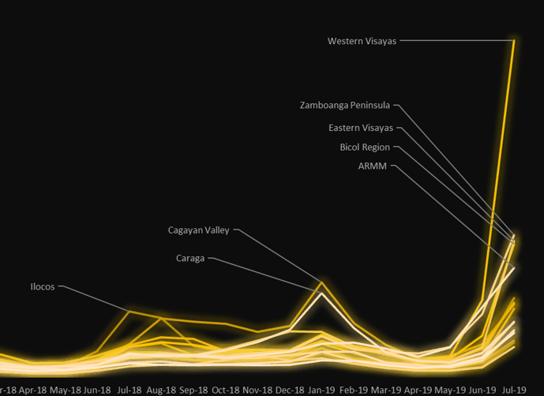
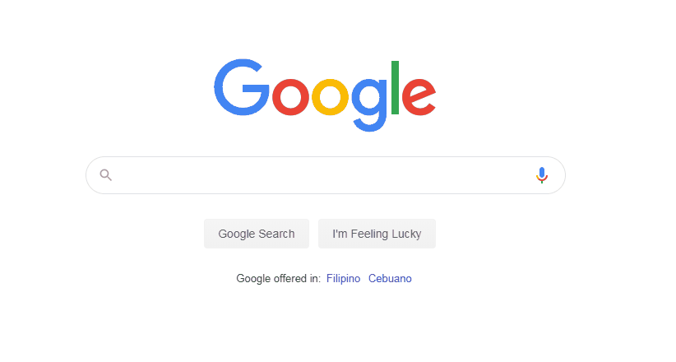
Use Google Searches to Detect Issues
Source: Google Searches (% Growth, January 2017 = 1)

Slide 4
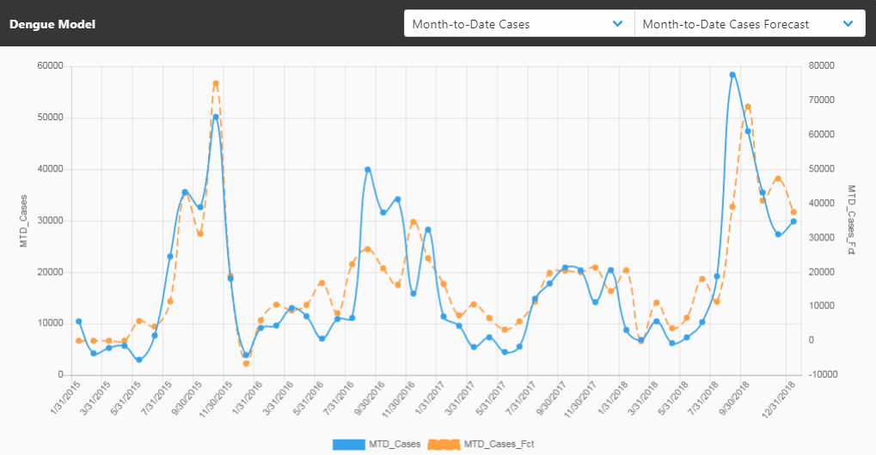
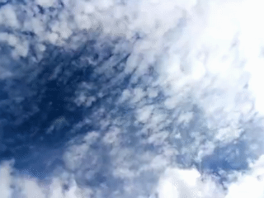
Use Climate Data To Forecast Trends
Sources: DOST-PAGASA Climate Data, Google Search Trends, DOH Dengue Monitoring Reports

Slide 5
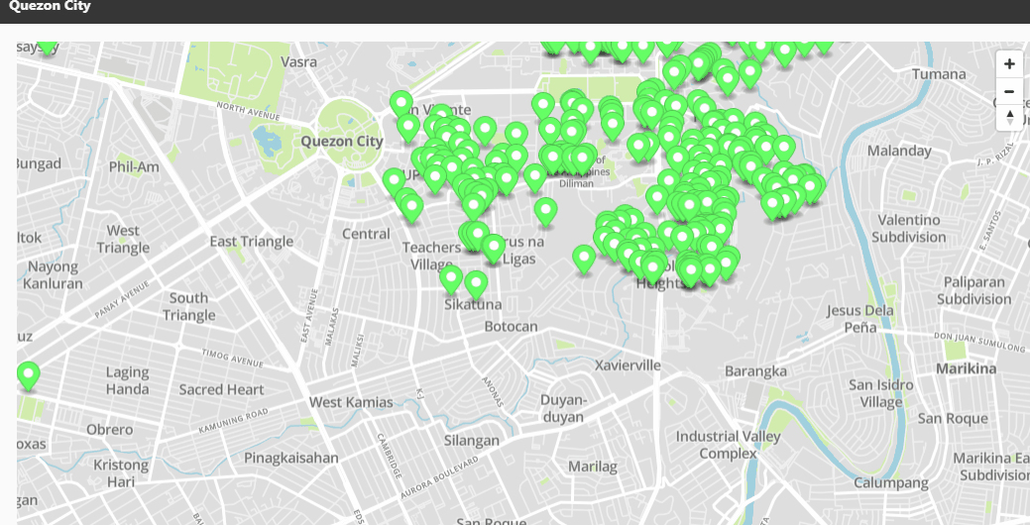
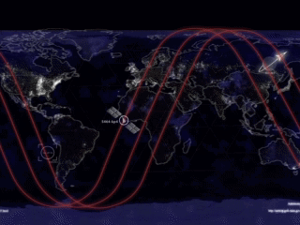
Use Satellite Data To Target Mosquitos
Sources: Sentinel-2 (Copernicus), Landsat 8: NDWI, FAPAR, NDVI

Slide 6

We Solve For SDG 3 By Preventing Dengue
For every single day we can reduce the lag in response time we save:
5
1,130
Lives
New Cases

Slide 7
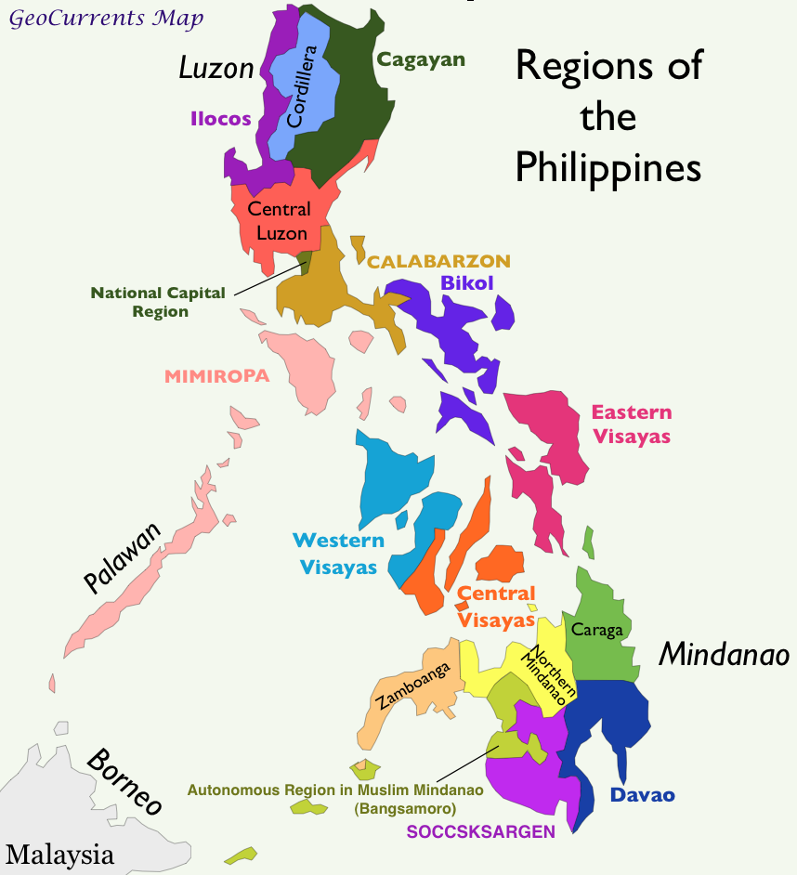
Target Beneficiaries
Free to access dashboard for public use
Target user: National and Local Government Health Departments
Use it to generate localized dengue alerts and also target areas for interventions such as fumigation, misting, inoculations and medical supplies.

Slide 8
Save Data. Save Lives.
aedesproject.org

